Slide 1
State Travel Reimbursement Procedures and Processes

Slide 2
Agenda
POLICY AND PROCEDURE MEMORANDUM 49 (PPM 49)
Travel Expense Entries in LEO (Demonstration)

Slide 3
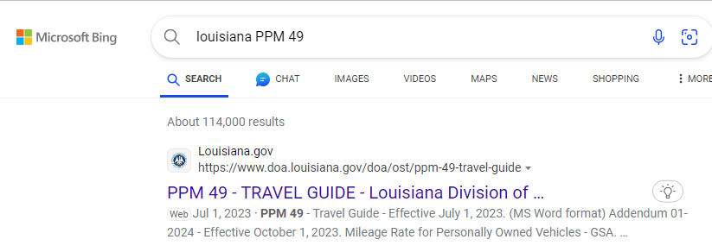
PPM 49 – Travel Guide

Slide 4
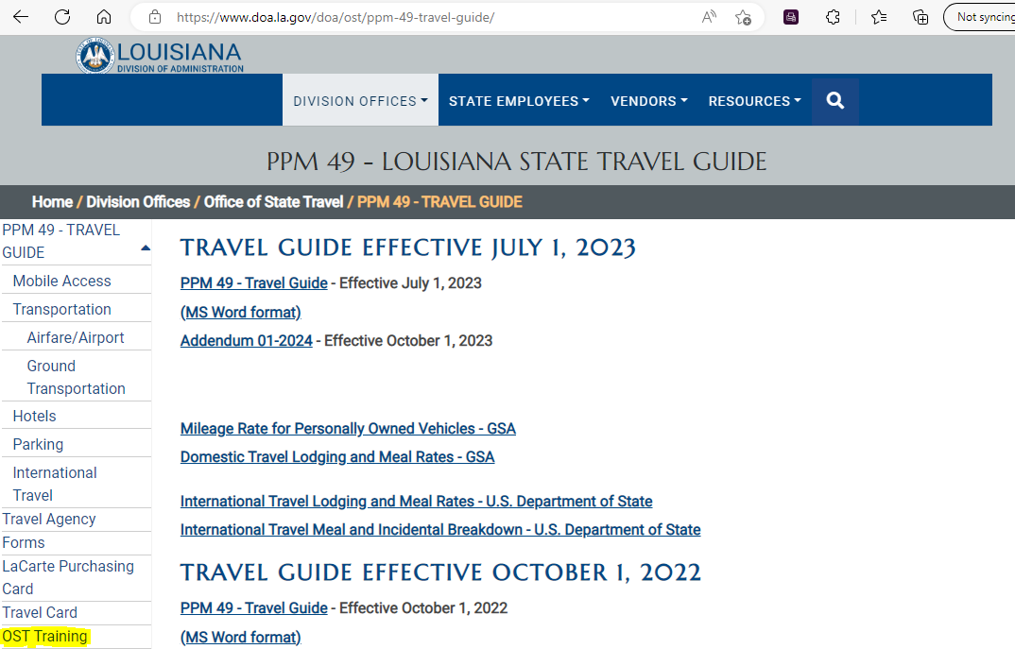
PPM 49 – Travel Guide

Slide 5
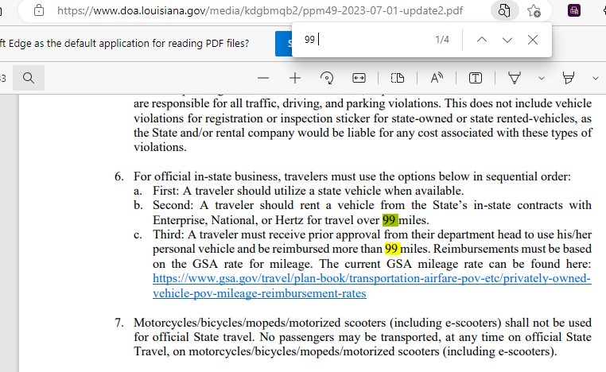
PPM 49 – Travel Guide (Ctrl+F)

Slide 6
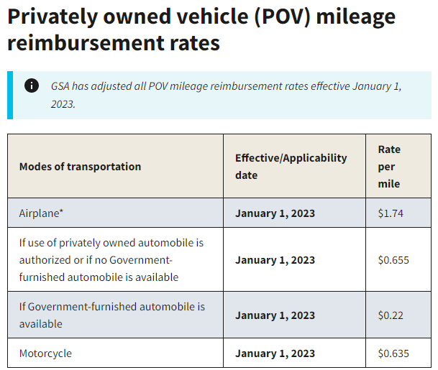
Mileage Rate for Personally Owned Vehicles - GSA

Slide 7
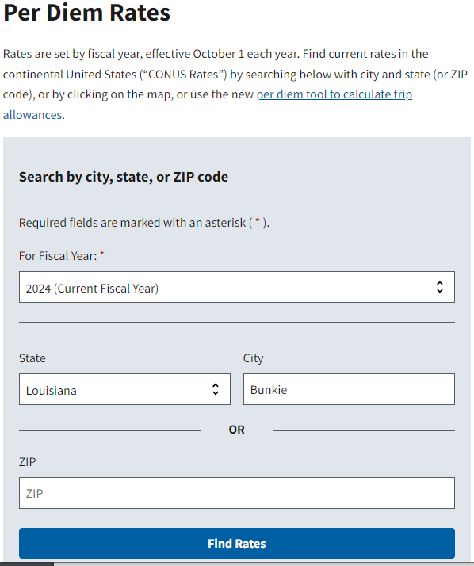
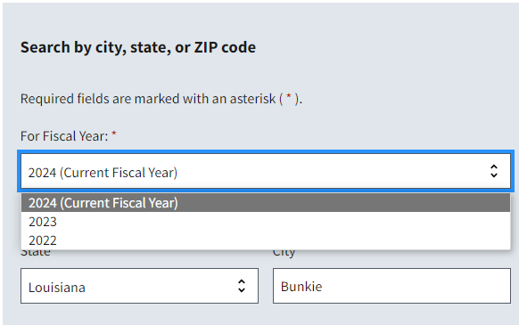
Domestic Travel Lodging and Meal Rates – GSA

Slide 8
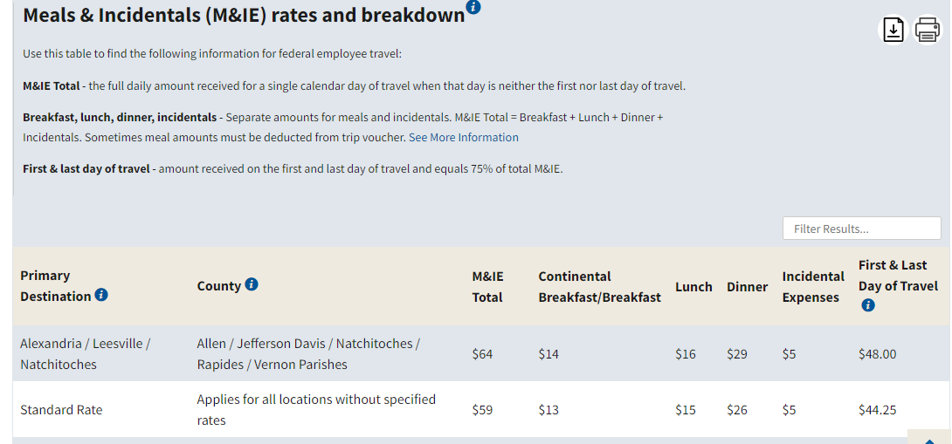
Bunkie is a city in Avoyelles Parish. That parish is not on the GSA County list. Standard Rate must be used.

Slide 9
Federal Travel Regulation

Slide 10
Entry for meals provided on the first/last day
Lunch provided on the last day of a conference in Bunkie.
Total First/Last Day of Travel is $44.25.
Lunch rate is $15.00.
Total amount for the last day is $29.25 ($44.25 - $15.00 = $29.25)

Slide 11
Required documentation for reimbursement
1. Training and/or Travel Request Authorization.
2. A formal agenda, program, letter of invitation, or registration fee.
3. A written approval for expense reimbursement if PPM 49 requires it.
Example:
A traveler must receive prior approval from their department head to use his/her personal vehicle and be reimbursed more than 99 miles.
Department head or his/her designee may approve reimbursement to a traveler for airline charges for one checked bag for a business trip of 5 days or less and for two checked bags for business trips exceeding 5 days. Additional luggage or equipment required for the business travel may be reimbursed with justification and receipts.
4. Copies of itemized receipts to support all expenditures.
5. LaCarte policy must be followed.

Slide 12
Deadlines for Submission
Submit your travel reimbursement request as soon as you return from your trip.
Any travels dated prior to July 1st must be entered in LEO no later than July 15th with no exceptions.
For travels dated prior to July 1st that were not entered in LEO before July 15th, a Travel Expense Account form with all supporting documentation must be submitted to Financial Services.
Travels that cross a fiscal year (June through July) will be reimbursed out of new fiscal year. Payments will be processed as new fiscal year funds are available.
Any delays in the submission of travel reimbursement requests at the end of the fiscal year will result in delaying reimbursement. A check will be cut and mailed to the traveler as new fiscal year funds are available.

